Slide 1
HIV Prediction Model
CMKE 136 Capstone Project – Final Presentation
Christopher Rayman

Slide 2
Introduction
Task
To build a prediction model that will determine if a patient will see an improvement after 16 weeks of starting medical treatment
Data
1000 Records of patients who have been tested HIV positive and have not begun medical treatment
Response codes of 0 or 1 representing if a patient has seen improvement
Reverse Transcriptase enzyme is responsible for copying the HIV genome within the cell
Protease protein cuts the string of amino acids into functional units required by the HIV life cycle
Viral Load count: the number of viral particles in that are present 1mL of blood
CD4 count: the number of white blood cells that are found in the same 1mL of blood

Slide 3
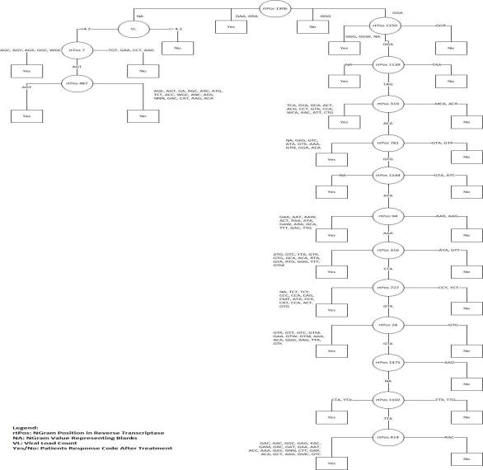
Model 1 – Decision Tree

Slide 4
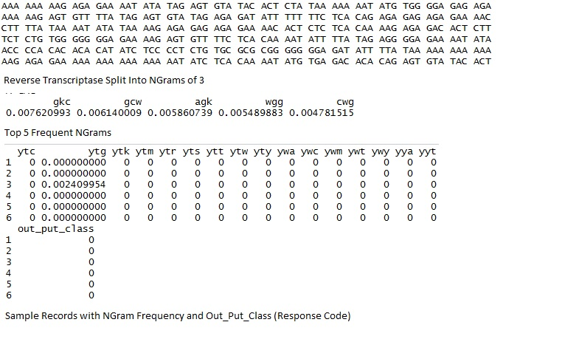
Model 2 – Text Mining

Slide 5
Model 3 – Logistic Regression

Slide 6
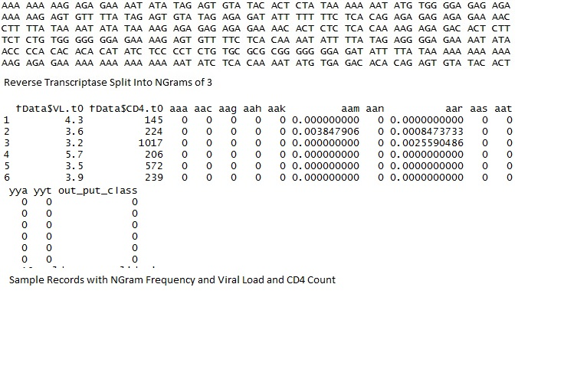
Model 4 (Combination of Models 2 and 3)

Slide 7
Results
Model | Accuracy | Precision | Recall
Model 1 | 81.1 % | 92.6 % | 94.9 %
Model 2 | 64.4 % | 89.2 % | 72.4 %
Model 3 | 80.5 % | 96.6 % | 84.6 %
Model 4 | 64.9 % | 90.0 % | 73.5 %

Slide 8
Conclusion
Model 1 gave the best highest accuracy of 81.1 % and the highest recall rate
Good example use machine learning for choosing the most optimal attributes to provide highest accuracy
Does not mean that the other methods are less valid
These models could also be used for medical/biological research

Slide 9
References/Q&A
Kaggle Data
https://www.kaggle.com/c/hivprogression
YouTube Weka Reference
https://www.youtube.com/watch?v=m7kpIBGEdkI
Wikipedia Ngrams/Kmer
https://en.wikipedia.org/wiki/K-mer
Final Code can be found on Github
https://github.com/c2rayman/cmke136/tree/final/final
CMTH 642
Lecture 9: Classification: kNN and Logistic Regression
Lecture 10: Text Classification Problem
Questions?

